Slide 1
Green School
Marriotts Ridge High School
2012-2013
Carrie Noel-Nosbaum, Room 308

Slide 2
“What is that?”
“My classroom is a Green Environment.”
“A Green Environment?”
“It pretty much means I’m awesome because I pledge to be environmentally friendly here at school.”

Slide 3
I pledge to save energy by:
turning off lights when I leave a room
using only one light when I am working alone in my room or using a desk lamp

Slide 4
I pledge to save paper by:
copying double sided when possible
copying multiple pages to one side if possible
doing my best to not waste paper when printing and copying

Slide 5
I pledge to reduce, reuse and recycle by:
having more recycling than trash in my classroom
using scrap paper
using a reusable drinking vessel

Slide 6
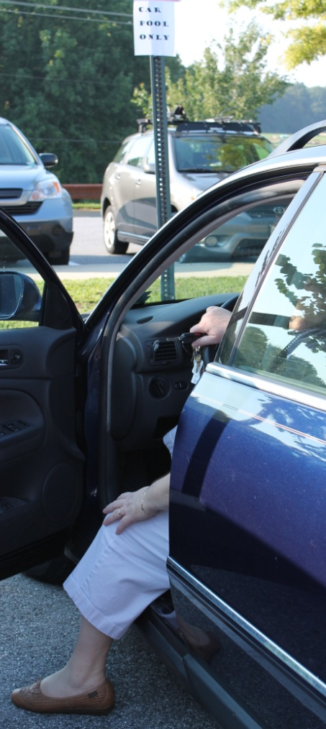
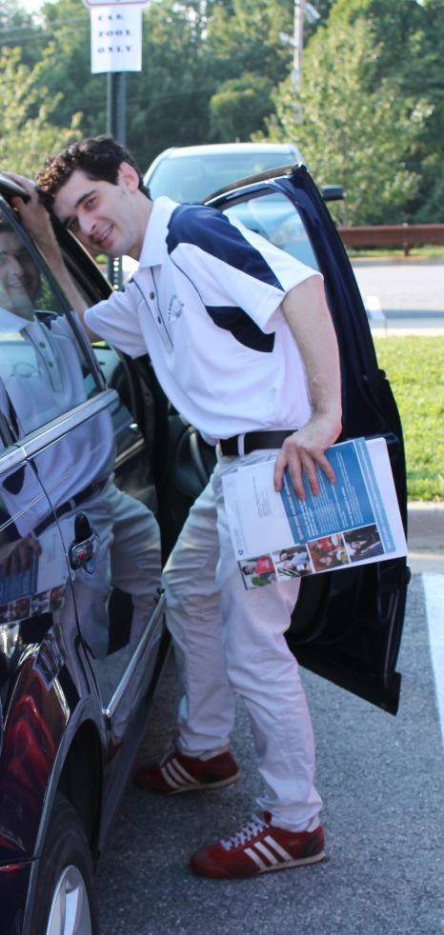
I pledge to reduce my carbon footprint by:
carpooling to work if possible
keeping my windows closed so that the HVAC doesn’t have to work extra hard
please notify Clovis of any issues with temperature in your classroom

Slide 7
PLEDGE SHEETS WILL BE IN THE MAILROOM FOR YOU TO SIGN WHEN YOU FEEL COMFORTABLE PLEDGING
Feel free to speak with me if you have any questions or would like to be involved with our Green School Team and/or application efforts.
THANK YOU!

